Slide 1
Final Proposal Presentation
Team Poba:
Anthony Peters
Shane Pooler
Ryan Stevenson
Kevin White

Slide 2
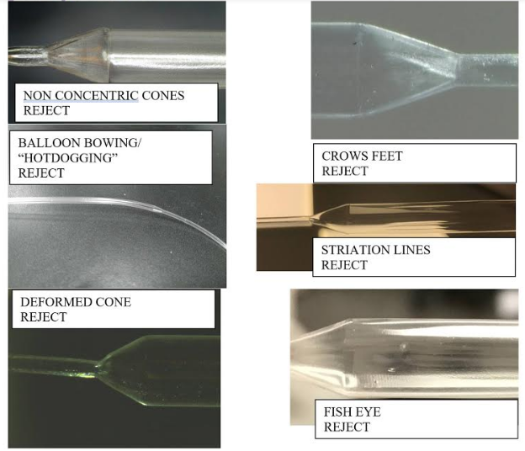
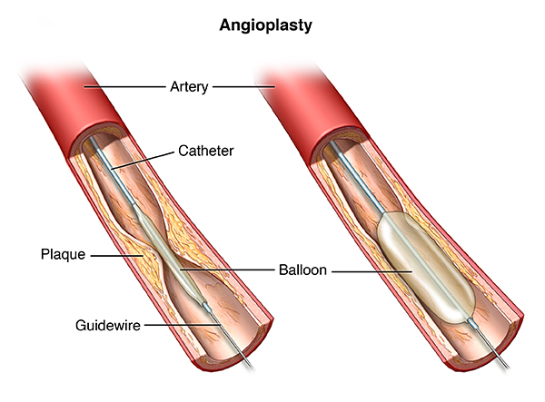
Project Description
Design and manufacture an automated visual balloon inspection device for POBA medical
Design must be compatible for different balloon sizes and lengths
Determine dimensions and detect any defects
Catheter Balloon for artery
White
11/6/17
POBA
Slide 2
Balloon Defects

Slide 3
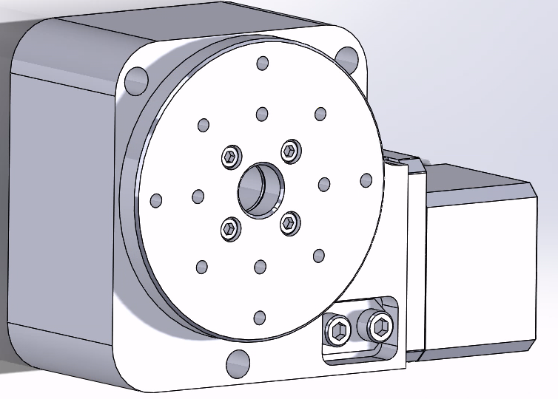
Rotary Design
Design must be able to rotate the balloon 360 degrees
Utilize two RM-3 Rotary Stage manufactured by Newmark Systems
RM-3 Specifications
Max Speed | 30 degrees/sec
Max Load Capacity | 45 lbs
Travel Range | 360 degrees
Stage weight | 3 lbs
Material | Aluminum Alloy
White
11/6/17
POBA
Slide 3
RM-3 SolidWorks model

Slide 4
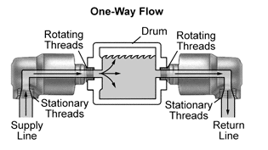
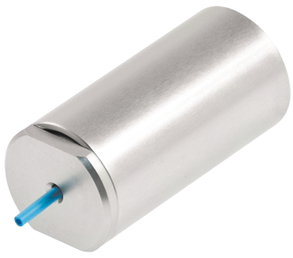

Rotary Design (cont.)
Design must be able to rotate while air pressure is inputted
Rotary Joint (Rotary Union) permits flow of air/fluid into and out of a rotating part
Use two stainless steel rotary joint rated for 300 psi (Air)
Rotary Joint
Pneumatic connector and mandrel
One way flow illustration
White
11/6/17
POBA
Slide 4

Slide 5
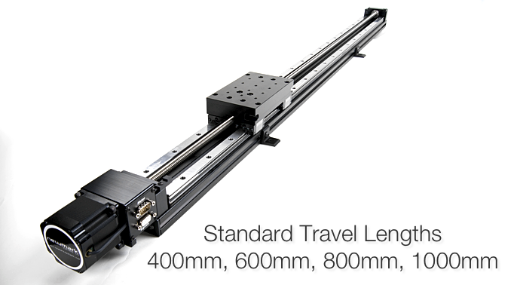
Linear Design
Design should be able to scan a 300mm balloon or smaller with 70+mm of excess plastic on each side.
Therefore we chose the 600mm option
Max Speed | 100 mm/sec
Max Load Capacity | 150 lbs.
Travel Range | 600mm
Stage Weight | 15.5 lbs.
Material | Aluminum alloy
Stevenson
11/6/17
POBA
Slie 5

Slide 6
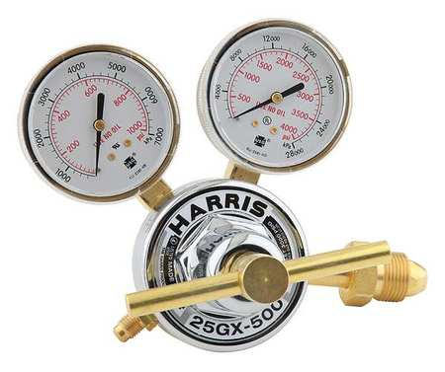
Pressure Input Design
Air compressor valve
Gas service: Argon, Helium, Nitrogen
Max Inlet Pressure: 3000 psi
Delivery Pressure Range: 500 psi
Peters
11/6/17
POBA
Slide 6
Notes:
To increase the quality of the pictures of the surface of the catheter balloon, air will be pumped through the balloon. This air will be a mixture of oxygen and nitrogen. The source of the oxygen and nitrogen will be from tanks. The outlet pressure of the tanks will be roughly 1000 psi. However the balloons are only made to withstand 300 psi at the most. To make it so the balloons don’t pop, we will install a 3 prong air compressor valve. This will help combine the oxygen and nitrogen gas into one solution. While at the same time, lowering the pressure to make it suitable for the catheter balloons.

Slide 7
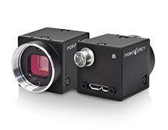
Camera Design
Manufactured by Edmund Optics.
lightweight, compact.
Ideal for integration into machine vision systems.
Including a 16MB image buffer.
LED status indicators.
These USB 3.0 cameras include capture software and SDK.
Mount available.
BFLY-U3-23S6C-C USB 3.0 Blackfly®
Camera Specifications
Mega Pixels | 2.3
Type | Colored Camera
Frames Per Second | 41 fps
Memory | 1 MB nonvolatile Flash memory
Dimensions | 29 x 29 x 30 mm
Type of Sensor | Progressive Scan CMOS
Weight | 36g
Transfer Speed (Mbit/s) | 5000
Pooler
11/5/17
POBA
Slide 7
Notes:
Our design needed to incorporate a type of microscopy camera powerful enough to take pictures of defects that are too difficult to see with the naked eye. The camera needed to also be programmable and be able to progressively scan each catheter . We chose the Blackfly camera by Edmund Optics because it is ideal for microscopy. design for machine vision systems, and includes capture software. This camera is compact and lightweight which doesn't add much volume to the overall design.

Slide 8
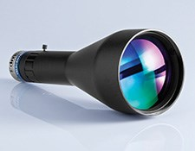
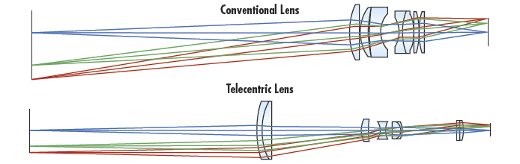
Camera Lens
Manufactured by Edmund Optics.
Designed for machine vision production applications that require accurate measurements.
These lenses combine high quality optics with a simplified non-focusing mechanical design and adjustable iris with a locking set screw.
Each lens also features a standard front filter thread for use with color filters, polarizers, protective windows, and illumination adapters for LED or fiber-optic ring lights.
TECHSPEC 0.16X SilverTL™ Telecentric Lens
Pooler
11/5/17
POBA
Slide 8
Notes:
The addition of the TECHSPEC 0.16X SilverTL™ Telecentric Lens by Edmund Optics will allow us to take even more accurate images. This particular lens attachment was engineered specifically for machine vision production applications that require accurate measurements. With this lens we are able to attach color filters, polarizers, protective windows, and illumination adapters for LED or fiber-optic ring lights.

Slide 9
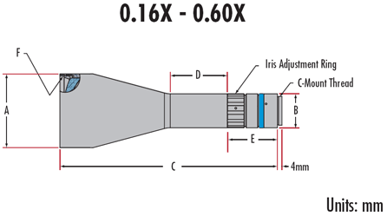
Camera Lens (cont.)
Lens Specifications
Primary Magnification | 0.16X | Max Diameter (A) | 65mm
Working Distance | 177mm | Mounting Diameter (B) | 30mm
Aperture | f/6-closed | Length (C) | 191mm
Field of View | 40mm | Mounting Length (D) | 50mm
Weight | 500g | Mounting Offset (E) | 43mm
Pooler
11/5/17
POBA
Slide 9

Slide 10
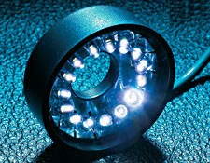
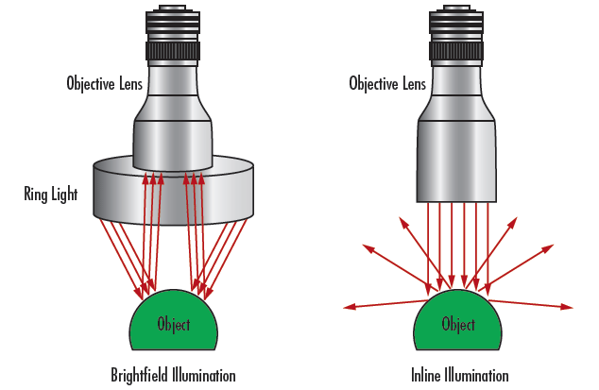
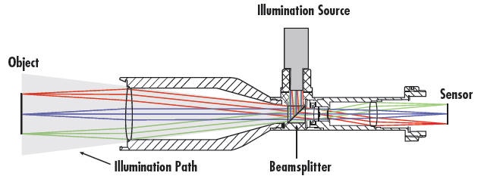
Camera Lens (cont.)
Ring light attachment
Lighting options
Inline light attachment
Pooler
11/5/17
POBA
Slide 10
Notes:
For lighting the balloon we can use a ring light lense attachment, or an inline illumination source. The inline illumination is shown the top right image . And both light sources can be purchased online through Edmund Optics.

Slide 11
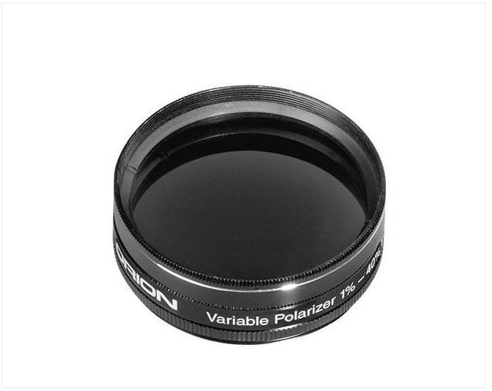
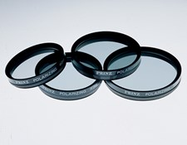
Polarization Design
Variable Polarizer
Placement on the camera
Peters
11/6/17
POBA
Slide 11
Notes:
There are two different types of routes we could go with polarizers. There are regular polarizer that only spit out a small range of wavelengths. There are also variable polarizers that can output a much wider range of wavelengths. The clear decision is to use a variable polarizer. The plan is to put one on the variable polarizer on the camera lense. Causing all of the pictures taken by the camera to be polarized. The reason for using polarized light is because it helps make pictures more clear when it comes to transparent objects like glass, water and catheter balloons. I do not have any numbers to share with you on this part of the project because POBA already has picked the variable polarizer they want and they don’t know the specifics of it.

Slide 12
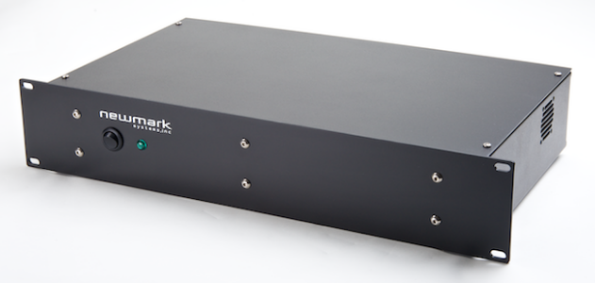
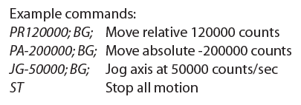
Controller Design
NSC-G2 Series Motion Controller from Newmark Systems
  Control’s up to two axis (Rotary and Linear systems)
  4 inputs and 4 outputs which can be used to program camera
  Includes power supply, motor drives, software (GalilTools), and required cables
  Communication interface: RS-232 and Ethernet
  Input Voltage: 85-264 VAC
NSC-G2 Motion Controller
White
11/6/17
POBA
Slide 12

Slide 13
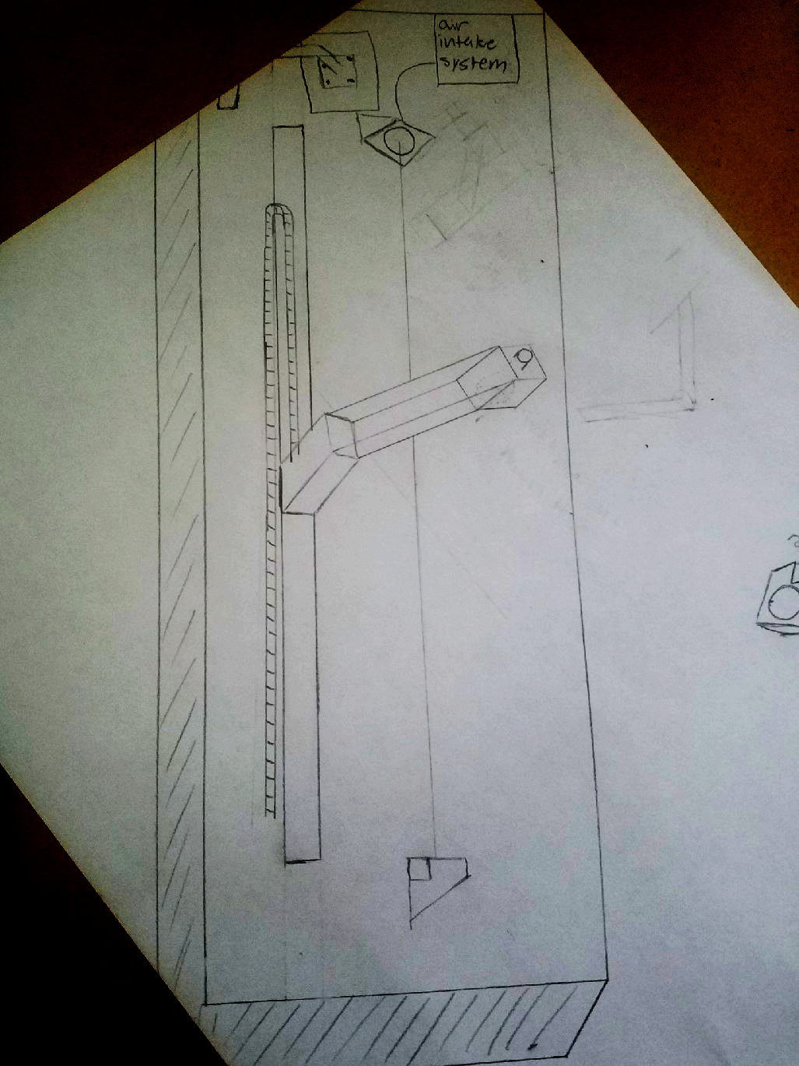
Final Design
Stevenson
11/6/17
POBA
Slide 13

Slide 14
Final Design
Final length will be just under 5ft long
On the inside of the frame will be the motion controller and the computer plus all of the wiring.
Things to consider
  Material for the frame, preferably something low cost. Weight or durability not high on priority
  Final Design of camera frame
  Design of air intake system (inboard or outboard)
  Type of computer
  Size of monitor
  Depth and internal space of design to account for any cooling needed
Stevenson
11/6/17
POBA
Slide 14

Slide 15
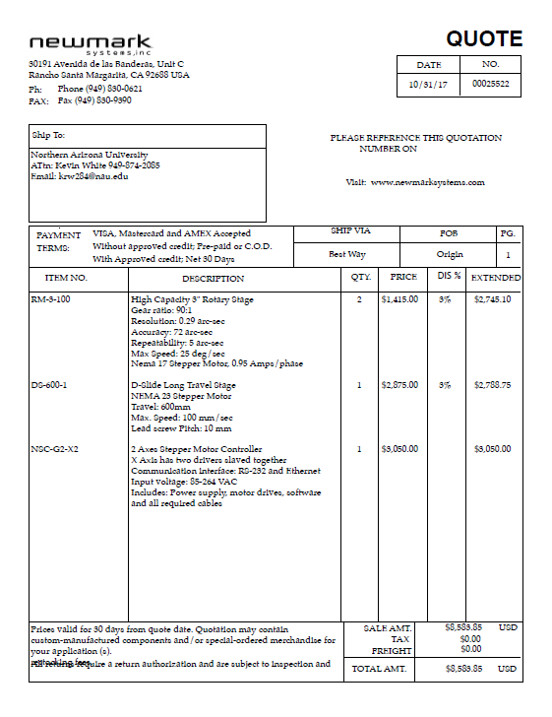
Budget
Other estimated costs so far
Camera- $575
Cabling- $75
Cable Carriers- $100
Rotary Joint (2) - $450
Air compressor valve- $140
Total used- $9,923.85
Total left- $5,076.15 - $10,076.15
Peters
11/6/17
POBA
Slide 15
Notes:
As of now, we have most of the important parts quoted. These parts include what is listed in the quote on the slide and the air compressor valve. What is listed on the quote shown is rotary motion, linear motion, and the control system for these systems that make them automated. Together they come out to about $9500. This leaves roughly $5500 to $10500 left in our budget. The reason for having a $5000 window for our money left is because POBA said that they estimate this will cost $15000 but they are willing to spend up to $20000. The money we have not used/plan to use will be put towards what the frame of our machine will be made of.

Slide 16
Schedule
Have final CAD design before we leave for thanksgiving.
  Main components already modeled, makes design easier than we initially expected
Have full CAD package before end of semester.
  FEA analysis and more
Start building when we come back in spring.
  POBA will do all of the ordering for us at the end of the fall semester
Identify issues and make corrections.
  Fitment or design issues
Have design finished by mid to late february.
Utilize march for programming.
Have completed project by april.
Stevenson
11/6/2017
POBA
Slide 16
Notes:
As of now we are on schedule. Thankfully most of our subsystems were already made on solidworks so created a complete final design will be much easier than we originally thought. This semester is now focused on creating the solidworks design. Like I said last presentation, we will order our parts over winter break. Giving the manufacturer time to make the parts we request. If timing works out correctly, we will get all of our requested parts by the time we get back from winter break. We will then spend the next month building and correcting any issues if they arise. Once our machine is completely built, we will turn to the programming portion of the project until it is completed in April.

Slide 17
The End
Any questions?

